Slide 1

Agile Development & DevOps Premier Software Technologies (Pvt) Ltd
Udeshika Senanayake
02/15/2023

Slide 2
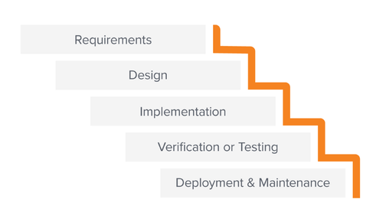
Waterfall Methodology

Slide 3
Why We Should Switch to Agile From Waterfall?
The waterfall methodology lacks to deliver on a promise. It is among the prime reasons for the modern-day shift.
The waterfall has some downsides.
It is impossible to identify all requirements at the start of a project.
It can take a long time for feedback from users to get incorporated into a project due to the long time required for testing and bug fixes.

Slide 4
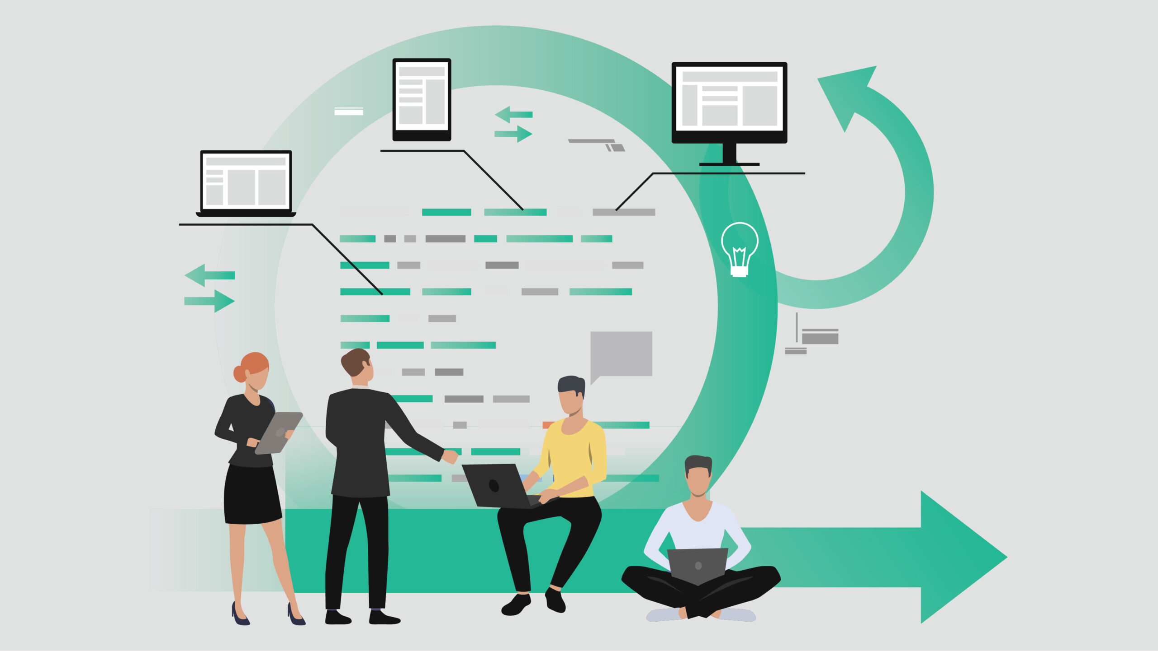
Agile Methodology
Agile methodology is an iterative and incremental approach to software development.
That focuses on delivering high-quality software quickly and efficiently.
It emphasizes collaboration, flexibility, and continuous improvement throughout the development process.

Slide 5
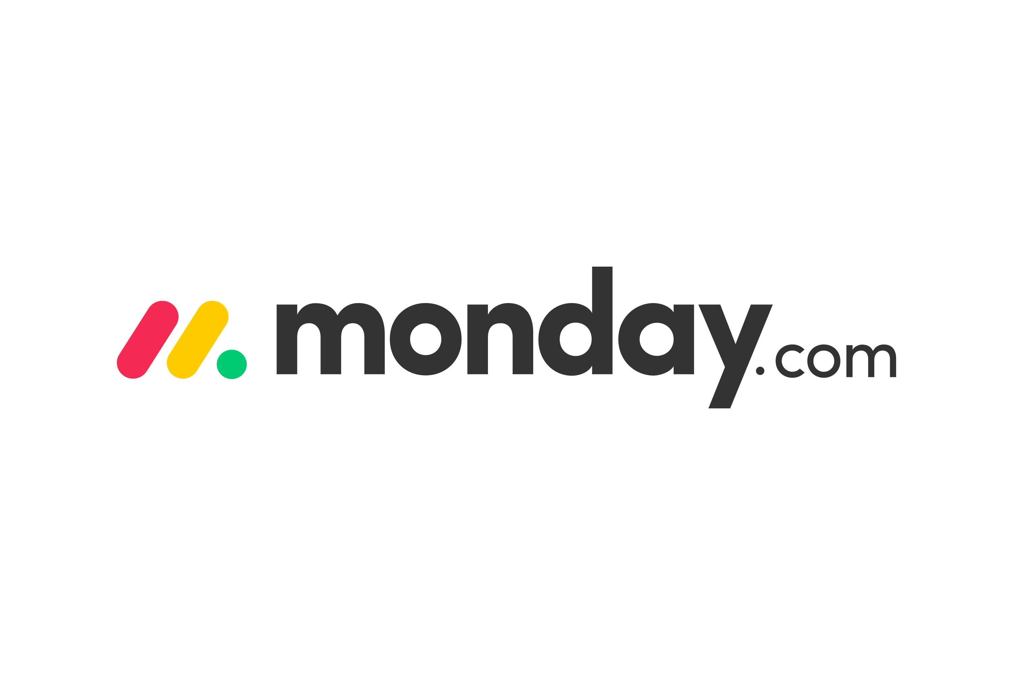





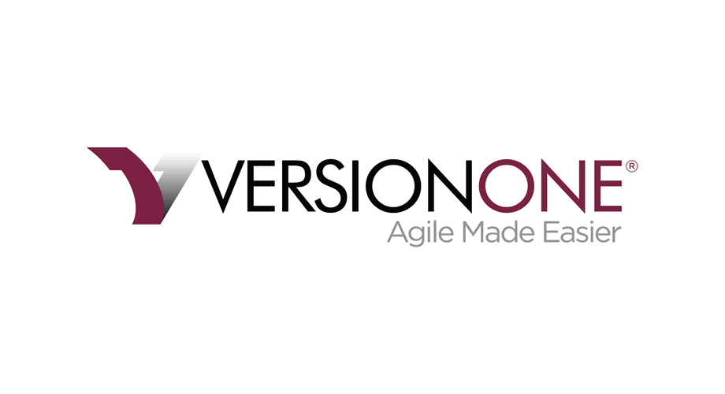
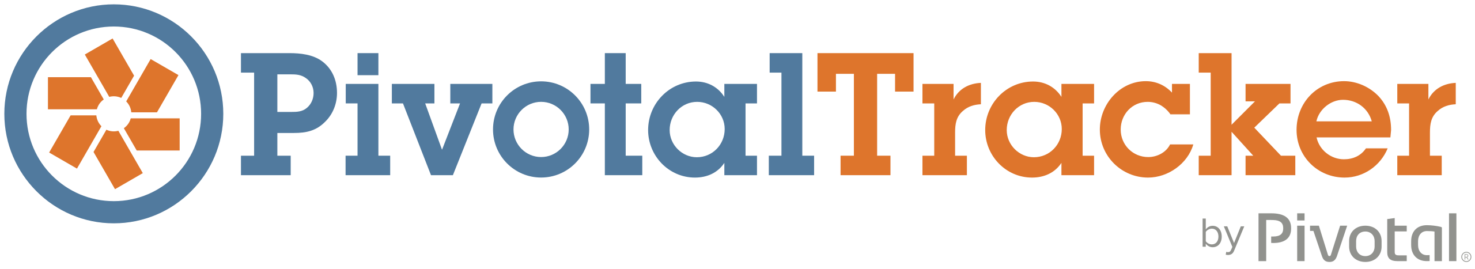

Agile Tools
JIRA
Trello
Asana
Basecamp
VersionOne
Agile Central
Pivotal Tracker
Monday.com
Scrumwise

Slide 6
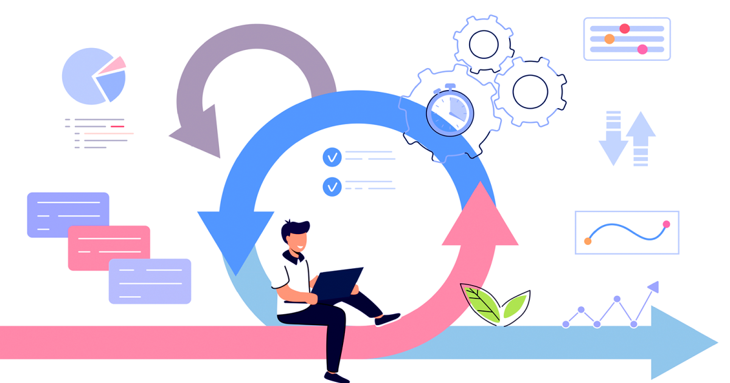
Benefits of using Agile tools
Improved collaboration and communication among team members
Increased transparency and visibility into project progress
Streamlined project management
Enhanced flexibility and adaptability
Improved time-to-market
Better quality products
Customer satisfaction
Reduced risks
​
​

Slide 7
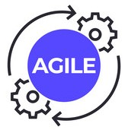
Benefits of adapting Agile tools to NexGen company
Faster time-to-market:
Agile tools support iterative and incremental development, allowing
teams to release smaller, high-quality features more quickly and respond faster to market demands.
Improved collaboration:
Agile tools facilitate team collaboration and communication, fostering cross-functional collaboration and knowledge sharing. This can help teams work together more effectively and reduce silos.
Increased transparency and visibility:
Agile tools provide real-time updates and progress tracking, which can help stakeholders stay informed about project status and potential roadblocks.
Better alignment with customer needs:
Agile methodologies prioritize continuous feedback and testing, allowing teams to quickly adjust their approach to better meet customer needs.

Slide 8

Benefits of adapting Agile tools to NexGen company
Enhanced flexibility and adaptability:
Agile tools prioritize flexibility and adaptability, allowing teams to quickly pivot and
adjust their approach as needed to better meet project goals and customer needs.
Improved quality and reduced risk:
Agile methodologies prioritize testing and continuous improvement, which can help
teams identify and address issues early in the
development process, leading to better quality
products and services and reduced risk.

Slide 9
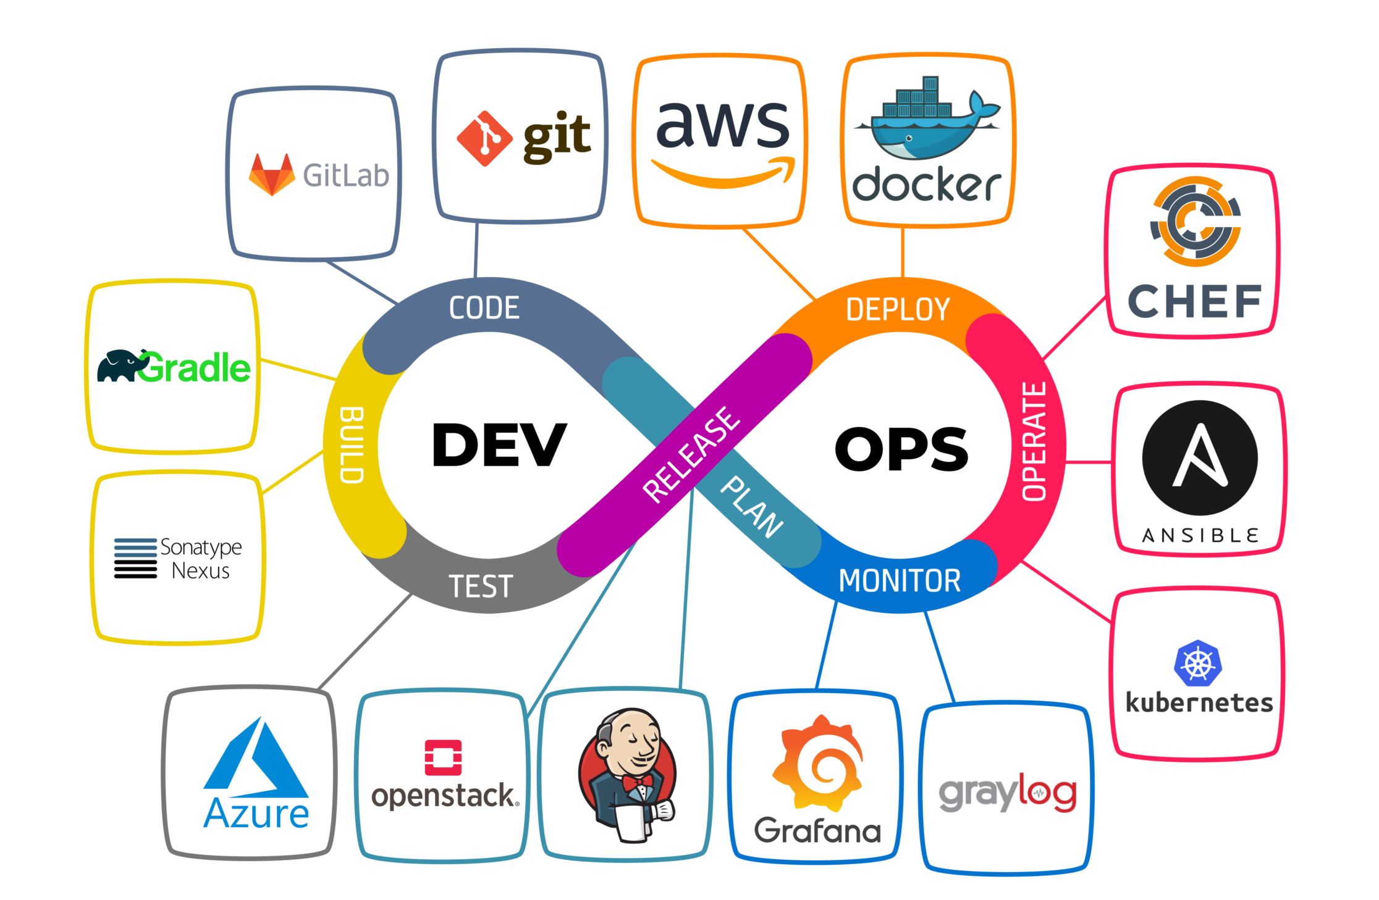
DevOps Methodology
DevOps methodology is an approach to software development and IT operations. That emphasizes collaboration and communication between development and operations teams to achieve faster and more efficient software delivery

Slide 10
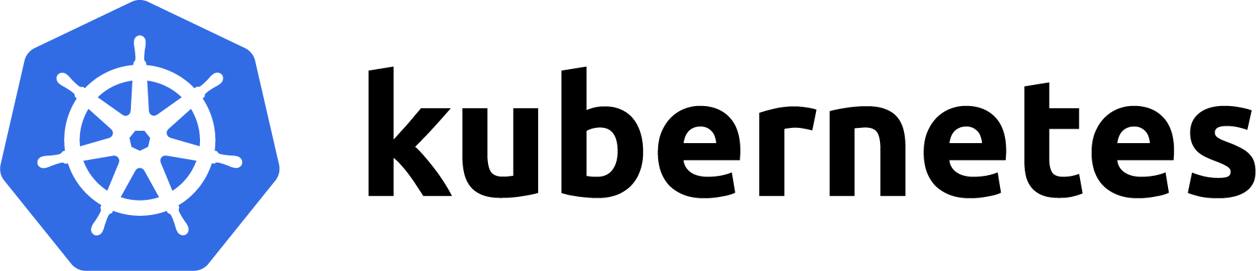
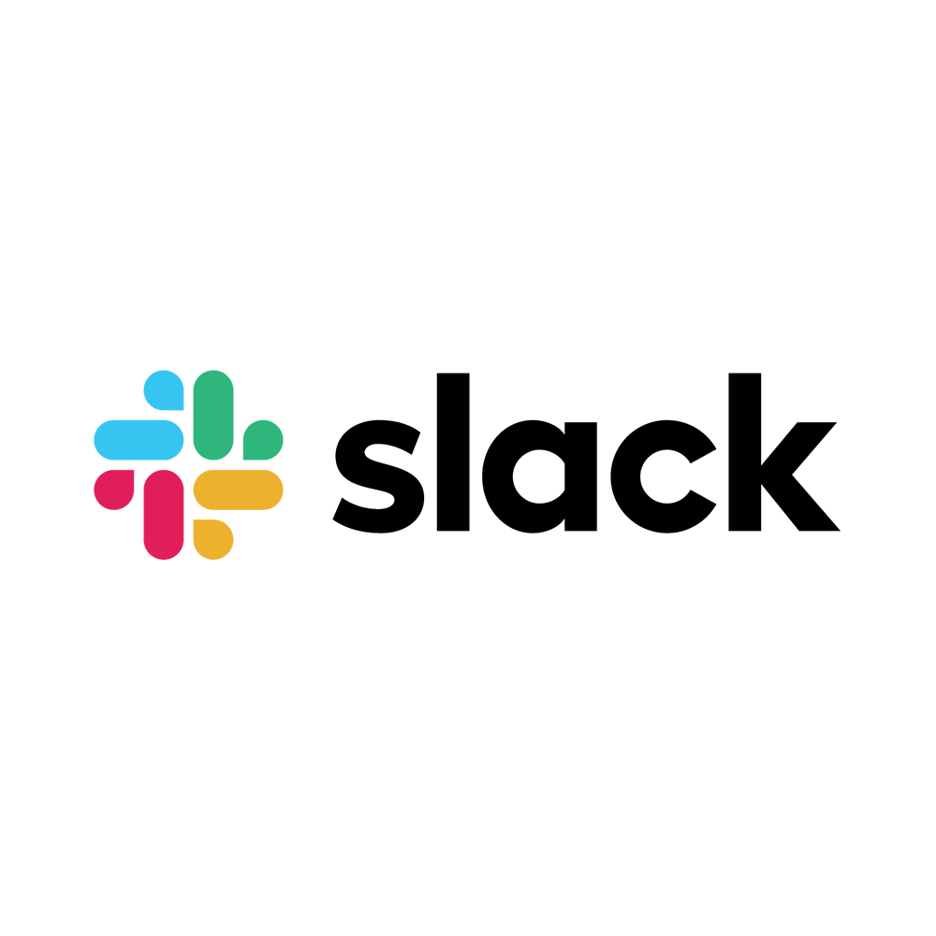
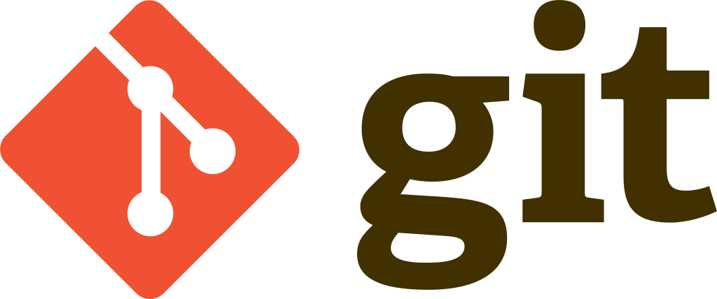
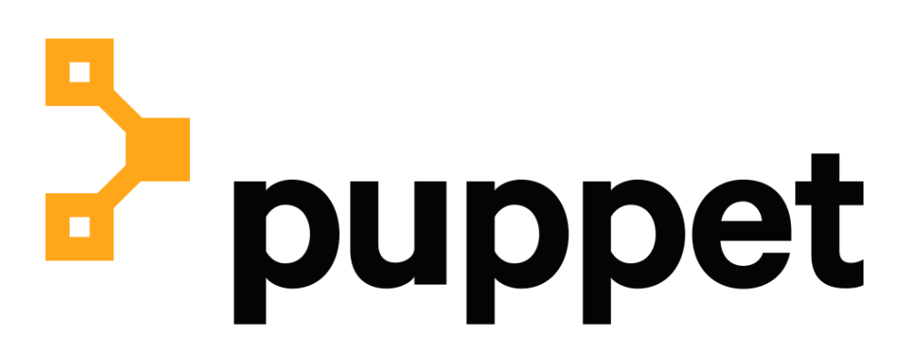
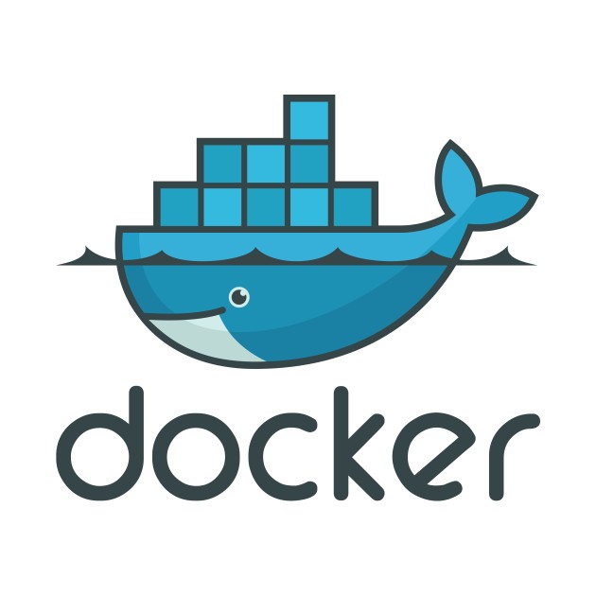

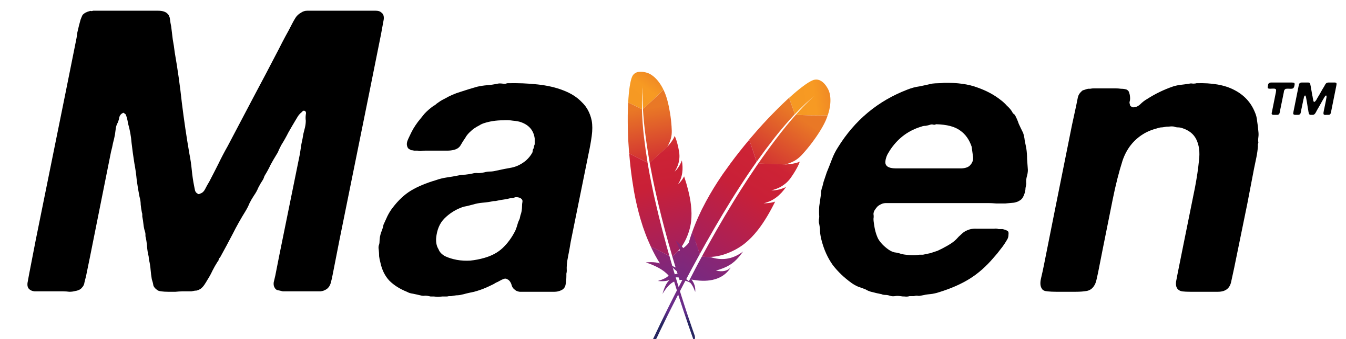

DevOps Tools
Version control tool : Git (GitLab, GitHub, Bitbucket)
Build tool : Maven
Continuous integration tool : Jenkins
configuration management tool : chef, Puppet, Ansible
Container Platforms : Docker, Kubernetes
Communication and Collaboration : Slack
Testing tool : Selenium, Gremlin
Cloud computing and storage tool : AWS CodePipeline, Azure DevOps

Slide 11
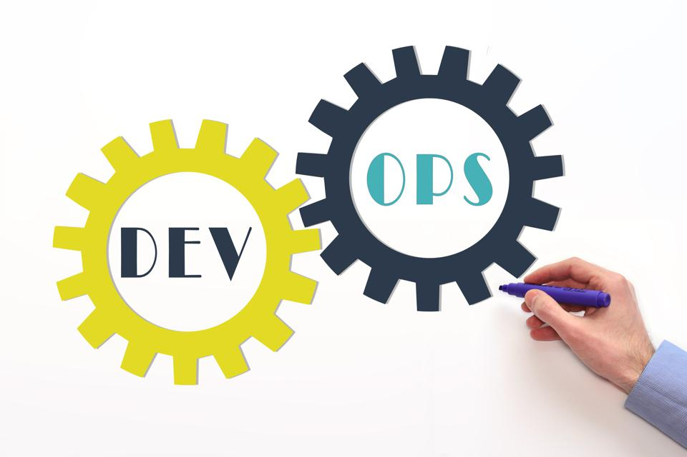
Benefits of using DevOps tools
Fast solutions
Increased efficiency
Improved customer experience
Faster ROI
Reduced failures
Continuous improvement
Improved performance

Slide 12
Benefits of adaptation DevOps tools to NexGen company
Faster time-to-market:
DevOps tools support continuous delivery and deployment, allowing teams to release features and updates to customers more quickly and frequently, and respond faster to market demands.
Improved collaboration and communication:
DevOps tools enable cross-functional collaboration and communication, breaking down silos and enabling faster and more efficient communication between teams.
Increased efficiency and productivity:
DevOps tools automate manual tasks, reducing errors and increasing the speed and efficiency of software development and deployment processes.
Enhanced quality and reliability:
DevOps tools automate testing and deployment processes, reducing errors and increasing the reliability and quality of software.

Slide 13

Benefits of adaptation DevOps tools to NexGen company
Better visibility and transparency:
DevOps tools provide real-time updates and progress tracking, which can help stakeholders stay informed about project status and potential roadblocks.
Increased scalability and flexibility:
DevOps tools provide automation and configuration management, making it easier for teams to scale infrastructure and respond to changing requirements quickly.
Improved security:
DevOps tools enable teams to implement security controls and testing into the development process and reducing security risks.

Slide 14

T H A N K you
Udeshika Senanayake​​
KUHNDISM221F-012
KUHNDISM221F-012@student.nibm.lk

